Slide 1

The Stakeholder Approach to Business, Society and Ethics
3
1
Notes:
1

Slide 2
Chapter Three Objectives
Define stake and stakeholder
Differentiate between production, managerial, and stakeholder views of the firm
Discuss three values of the stakeholder model
Consider the concept of stakeholder management
Identify the essence of stakeholder management
Explain stakeholder management capability (SMC)
2
Notes:
2

Slide 3
Chapter Three Outline
Origins of the Stakeholder Concept
Who Are Business’s Stakeholders?
Strategic, Multifiduciary, and Synthesis Views
Three Values of the Stakeholder Model
Key Questions of Stakeholder Management
Effective Stakeholder Management
Stakeholder Management Capability(SMC)
The Stakeholder Corporation
Stakeholder Power: Four Gates of Engagement
Principles of Stakeholder Management
Summary
Notes:
Origins of the Stakeholder Concept
What Is a Stake?
What Is a Stakeholder?
Who Are Business’s Stakeholders?
Production, Managerial, and Stakeholder Views
Primary and Secondary Stakeholders
Care, Strategic, and Environmental Stakeholders
A Typology of Stakeholders
Strategic, Mulitfiduciary, and Synthesis Views
Three Values of the Stakeholder Model
Stakeholder Management
Who Are Our Stakeholders?
What Are Our Stakeholders’ Stakes?
What Opportunities and Challenges Do Our Stakeholders Present to Our Firm?
What Responsibilities Does Our Firm Have to Its Stakeholders?
What Strategies or Actions Should Management Take?
Effective Stakeholder Management
Stakeholder Management Capability
The Stakeholder Corporation
Summary

Slide 4
Introduction to Chapter Three
Stakeholders
Individuals and groups with a multitude of interests, expectations, and demands as to what business should provide to society

Slide 5
Origins of the Stakeholder Concept
What is a stake?
An interest or a share in an undertaking and can be categorized as:
  Interest Right Ownership
  Legal
  Moral

Slide 6
Origins of the Stakeholder Concept
What is a stakeholder?
  An individual who possesses a stake

Slide 7
Who Are Business Stakeholders?
Government
Employees
Business
Community
Owners
Consumers

Slide 8
Who Are Business Stakeholders?
Evolution and Development of the
Stakeholder Concept
Views of the Firm
Production Managerial Stakeholder

Slide 9
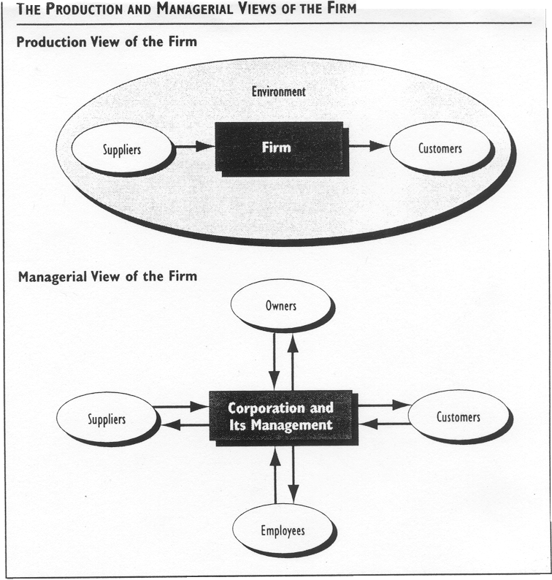
Who Are Business Stakeholders?
Production and Managerial Views

Slide 10
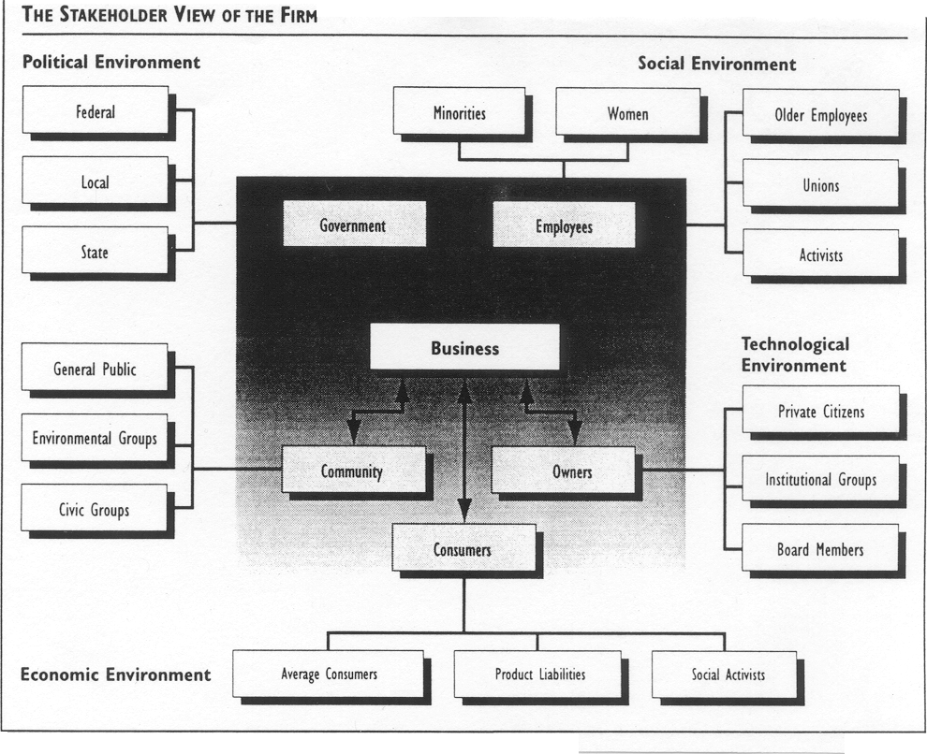
Who Are Business Stakeholders?

Slide 11
Who Are Business Stakeholders?
Primary and Secondary Stakeholders
Primary stakeholders are those stakeholders that have a direct stake in the organization and its success
Secondary stakeholders are those that have a public or special interest stake in the organization

Slide 12
Who Are Business Stakeholders?
Core, Strategic, and Environmental Stakeholders
Core stakeholders are essential to the survival of the
firm
Strategic stakeholders are vital to the organization
and the threats and opportunities the organization
faces
Environmental stakeholders are all others in the
organization's environment

Slide 13
Who Are Business Stakeholders?
Legitimacy, Power, Urgency:
A Typology of Stakeholder Attributes
Legitimacy refers to the perceived validity of the stakeholder’s claim to a stake
Power refers to the ability or capacity of a stakeholder to produce an effect
Urgency refers to the degree to which the stakeholder’s claim demands immediate attention

Slide 14
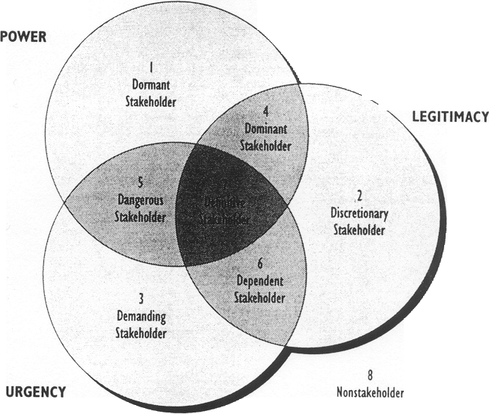
Who Are Business Stakeholders?
3-14

Slide 15
Strategic, Multifiduciary, and Synthesis Views of Stakeholders
Strategic approach considers stakeholders primarily as factors managers should manage in pursuit of shareholder profits
Multifiduciary approach considers stakeholders as a group to which management has a fiduciary responsibility
Synthesis approach considers stakeholders as a group to whom management owes an ethical, but not a fiduciary responsibility

Slide 16
Three Values of the Stakeholder Model
Descriptive
Instrumental
Normative

Slide 17
Key Questions In Stakeholder Management
Who are our stakeholders?
What are our stakeholders’ stakes?
What opportunities and challenges do the stakes and stakeholders present?
What economic, legal, ethical, and philanthropic responsibilities does our firm have?
What strategies or actions should our firm take to best manage stakeholder challenges and opportunities?

Slide 18
Key Questions In Stakeholder Management
Who are our stakeholders?
  Management must identify generic stakeholder groups and specific subgroups

Slide 19
Key Questions In Stakeholder Management
3-19

Slide 20
Key Questions In Stakeholder Management
What are our stakeholders’ stakes?
  Determine the nature/legitimacy of a group’s stakes
  Determine the power of a group’s stakes
  Determine specific groups within generic groups

Slide 21
Key Questions In Stakeholder Management
What opportunities and challenges do stakeholders present?
  Opportunities are to build good productive working relationships with the stakeholders
  Challenges are representative of how the firm handles the stakeholders

Slide 22
Key Questions In Stakeholder Management

Slide 23
Key Questions In Stakeholder Management
What economic, legal, ethical, and philanthropic responsibilities does our firm have to its stakeholders?
Philanthropic Responsibilities
Be a good corporate citizen.
Ethical Responsibilities
Be ethical.
Legal Responsibilities
Obey the law.
Economic Responsibilities
Be profitable.

Slide 24
Key Questions In Stakeholder Management
Stakeholder/Responsibility Matrix
Stakeholders | Economic | Legal | Ethical | Philanthropic
Owners
Customers
Employees
Community
Public at large
Social Activists
Other

Slide 25
Key Questions In Stakeholder Management
What strategies or actions should our firm take to best manage stakeholder challenges and opportunities?
  Should we deal directly or indirectly with stakeholders?
  Should we take the offense or the defense in dealing with stakeholders?
  Should we accommodate, negotiate, manipulate or resist stakeholder overtures?
  Should we employ a combination of the above strategies or pursue a singular course of action?

Slide 26
Key Questions In Stakeholder Management
Types of Stakeholders
Stakeholder’s Potential for Threat to Organization
High
Low
Stakeholder Type 4
Mixed Blessing
Strategy:
Collaborate
Stakeholder Type 1
Supportive
Strategy:
Involve
High
Stakeholder’s
Potential for
Cooperation
With Organization
?
Stakeholder Type 3
Nonsupportive
Strategy:
Defend
Stakeholder Type 2
Marginal
Strategy:
Monitor
Low

Slide 27
Effective Stakeholder Management
Careful assessment of the five core questions:
Who are our stakeholders?
What are our stakeholders’ stakes?
What opportunities and challenges do stakeholders present?
What economic, legal, ethical, and philanthropic responsibilities does our firm have?
What strategies or actions should our firm take to best manage stakeholder challenges and opportunities?

Slide 28
Effective Stakeholder Management
Stakeholder Management Capability
Rational level
Process level
Transaction level

Slide 29
Effective Stakeholder Management
Stakeholder Corporation
Stakeholder inclusiveness
Stakeholder symbiosis

Slide 30
Stakeholder Power:
Four Gates of Engagement
Awareness
Knowledge
Admiration
Action

Slide 31
Principles of Stakeholder Management
Acknowledge
Monitor
Listen
Communicate
Adopt
Recognize
Work
Avoid
Acknowledge conflict

Slide 32
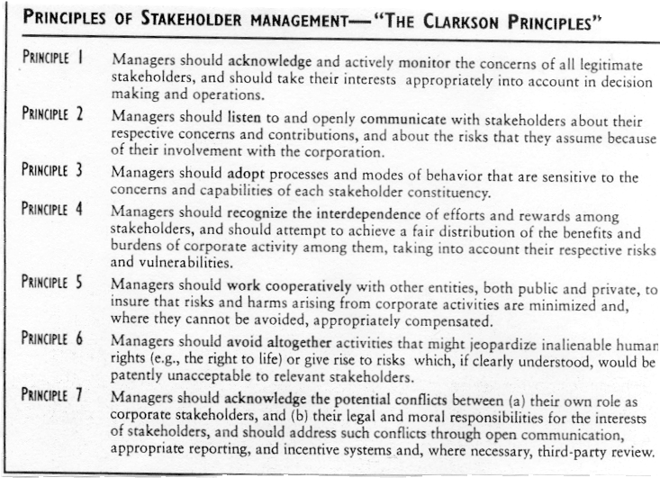
Principles of Stakeholder Management
3-32

Slide 33
Selected Key Terms
Core Stakeholders
Environmental Stakeholders
Legitimacy
Managerial view of
the firm
Power
Principles of stakeholder management
Process level
Production view of
the firm
Rational level
Stake
Stakeholder
Stakeholder inclusiveness
Stakeholder management capability (SMC)
Stakeholder symbiosis
Stakeholder view of
the firm
Strategic stakeholder
Transactional level
Urgency

