Slide 1
Introduction to Applied Creativity/Creative Problem Solving Basadur Model

Slide 2
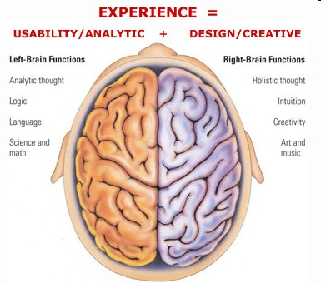
Creating Innovative Solutions
Creating innovative solutions requires a combination of the following:
Analytical thinking
Creativity
Analytical Thinking
The statistical tools of Lean Six Sigma work here
Harder to harness but tools exist to help us

Slide 3
10 Innovation Fundamentals
One conversation at a time
Use simple decoded language
Differentiate content from process
Separate diverge from converge
Defer judgement
Clarify where you are in the process
Quantify first, quality later
Build on each others ideas
Encourage wild ideas
Relax and have some fun!

Slide 4
What is Creative Problem Solving?
Creative Problem Solving involves the use of creative thinking to develop innovative solutions to complex problems
Notes:
Notes:

Slide 5
Separating content and process
Problem owner (client): The What of the problem; This is the person who is “hurting”, and the person who has to “make it happen”; Content Role
Participant: Also a Content Role; Helping the owner, selected on What they can contribute in knowledge, originality, etc.
Facilitator: Is a Process Role; Concerned with the “How” the group is going to work together to attack the problem.
Coach: A team member chosen by the facilitator to give feedback at the end of the meeting

Slide 6
Separate diverge and converge
DIVERGE
CONVERGE
EVALUATE
Yes Judgment
Yes logic
Narrow
Quality
Judgmental
Disciplined
Intellect
Adult
IDEATE
No Judgment
No logic
Widen
Quantity
Imaginative
Free
Gut
Child
1
2
DEFERRAL OF JUDGMENT
The process skill of withholding judgement to allow divergent thinking.
Keeps divergent and convergent thinking separate.

Slide 7
Killer Phrases during divergence
It’s not good enough
Ahead of times
Let’s form a committee
Who else have tried it?
Why hasn’t someone suggested it before if it’s such a good idea?
A good idea, but…
Against company policy.
All right in theory, but…
Costs too much
Not budgeted
Not our problem
Let’s discuss
We’ve never done it that way
It’s not part of my job
The client won’t go for it
Let’s make a survey first
OUCH!
No killer phrases please!
….Can you think of more?

Slide 8
Decode tribal language
HUH?
Decode tribal language please!
Make communication easier…spell it out!
CCI
BCI
QA
IT
GTKY
GTKM
WIIFM
WIIFU
LOL
LMK
NTH
GTH
IQN
SAP
SOP
CIC

Slide 9
Applied Creativity Creative Problem Solving
BASADUR Model
Act
Find Problem
C
Gain Acceptance
Find Facts
A
Implement
Solution
Formulate Problem/
Opportunity
Plan
Define Problem
Evaluate & Select
Find Ideas
B
Formulate Solution

Slide 10
A. Formulate problem/opportunity
Problem Finding
DIVERGE: Use Divergent Thinking. List problems, goals, opportunities, challenges, wishes, dreams, and other fuzzy situations that you sense you might like to try doing something about.
CONVERGE: Go back and select one of the above problems as your “fuzzy situation”

Slide 11
Checklist of questions to help ideate to find problems
Individual problem finding
How might you like to improve?
What has bothered you recently?
What risks and uncertainties do you face now?
What are the bottlenecks?
What would make you happy?
Organizational: Sensing the present
What minor problems could grow into big ones?
What turf issues are hindering progress?
What issues and problems require good teamwork between?
What more could be done to improve quality?
Organizational: Anticipating the Future
What changes, issues, problems, and opportunities for improvement do you visualize two years down the road?
What information would you like to get in advance to make your job a lot simpler?
What new issues will be raised by others if you don’t do it first?
What will be your customers biggest challenges over the next year?

Slide 12
A. Formulate problem/opportunity
Fact Finding
DIVERGE: List as many simple, clear answers to the following fact finding questions as possible. Defer judgment. Go for quantity. Think of WHO, WHAT, WHERE, WHEN, HOW, WHY, etc.
CONVERGE: Go back and select the most intriguing facts, gaps, revelations, etc.

Slide 13
KEY Fact Finding Questions
What do you know or think you know about this fuzzy situation?
What don’t you know that you’d like to know….
Why is this a problem for you?
What have you already done?
If this problem is solved, what would you have that you don’t have today?
What might you be assuming that you don’t need to assume?

Slide 14
A. Formulate problem/opportunity
Problem Definition
INITIAL DIVERGENCE: Deferring judgment, list as many creative challenges as you can based on these facts. Use your imagination! Start each challenge by saying “HOW MIGHT I..”
INITIAL CONVERGENCE: Select one challenge (or more than one if you have time) that seems most pertinent.
Notes:
Converge criteria:
-You have CONTROL, INFLUENCE, CONCERN

Slide 15
A. Formulate problem/opportunity
Problem Definition
FINAL DIVERGENCE: Perform a “Why – What’s Stopping” analysis using your selection as a beginning point. Make a challenge map below…
Why? Why would it help you to…?
How Might I…
What’s stopping? Is it that you have not yet…?
FINAL CONVERGENCE: Select one best challenge from above. Take this single best creative challenge to the next step.

Slide 16
B. Formulate solution
Idea Finding
Write the challenge that you selected
How might I….
a. DIVERGE: Now generate ideas which might solve this problem as defined above. Defer judgment!
b. CONVERGE: Select the best ideas and write in the grid
Idea Finding Techniques
Un-clumping
Building on wildest idea
The TRANSFORM Principle
Notes:
Tips:
The wilder the better
Unclumping the idea
Taming down the wild idea
TRANSFORM Idea

Slide 17
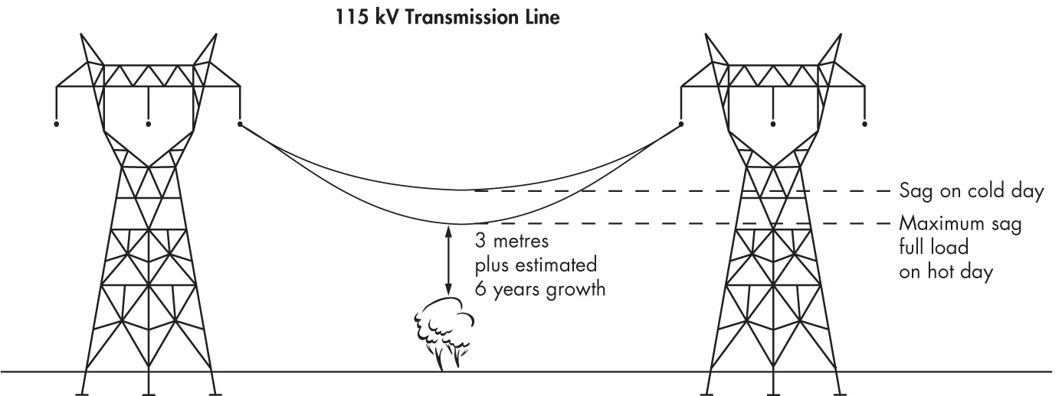
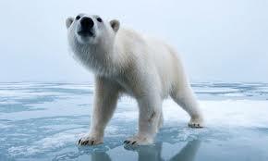
Building on the wildest idea
ALASKA

Slide 18
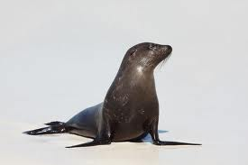
Building on the wildest idea
ALASKA
ICE

Slide 19
Building on the wildest idea
ALASKA

Slide 20
Building on the wildest idea
ALASKA

Slide 21
KEY Questions on Divergence
What do you know or think you know about this situation?
What don’t you know that you’d like to know….
Why is this a problem for you?
What have you already done?
If this problem is solved, what would you have that you don’t have today?
What might you be assuming that you don’t need to assume?

Slide 22
B. Formulate solution
Evaluation and Selection
a. DIVERGE: List all possible criteria which might be relevant to judging the ideas selected from step 4
b. CONVERGE: Select the most relevant criteria and write in the grid. Evaluate the ideas against criteria. Rate each on a 1 to 4 scale.
criteria
ideas
Excellent 4 3 2 1 Poor

Slide 23
C. Implement solution
Plan
Write your selected solution
a. DIVERGE: First, list answers to the following two questions:
What new problems might this solution create?
How might this solution be introduced?
b. DIVERGE: Second, list answers to the following question: What specific steps might I take to get the ball rolling to implement this solution?

Slide 24
C. Implement solution
CONVERGE: Action Plan – Write the steps you will take first in the “What” column of the action plan below, then fill in the “How”, “Who” (you), “Where” for this step. There is space for additional steps.
 | What | How | Who | When | Where
1
2
3
4

Slide 25
Creative Problem Solving Steps
Gaining Acceptance
Write a plan for selling your solution.
Whom do I need to convince of it’s value?
What problem of his/hers will this solution help solve?
List the benefits to him/her of this solution
List the possible objections to this solution
How might you “prove” each benefit?
How might each objection be overcome?

Slide 26
Creative Problem Solving Steps
Action!
Now it’s all up to you!
You need to take the actions indicated in step 6 and 7.
If you don’t, nothing will happen.
If you do, you will accomplish something valuable, develop yourself, and experience incomparable
AHA! Feeling!

Slide 27
examples
Sample Pre-work Planning
Sample CPS workshop report

