Slide 1
Office 365 Word Essentials
Corporate Training Materials

Slide 2
Module One: Getting Started
Inspiration exists, but it has to find you working.
Pablo Picasso
Welcome to the Office 365 Word Web App Essentials workshop. With Office 365, you can access your documents anywhere, and make some basic changes without using a computer where your desktop Office applications are installed.

Slide 3
Workshop Objectives
Understand the Word 365 browser interface
Upload a document to the Shared Documents library
Page through documents
Print from the reading view
Zoom to a different view
Open the pop out
Open in Editing View
Understand document conversion
Understand the Word web app interface
Print from the Editing View
Access the Reading View
Format fonts and paragraphs with a variety of features
Use bullets and numbering
Understand and use styles
Insert and work with tables
Insert links
Insert and work with pictures
Notes:
• Open and close documents in reading or editing view
• Understand the Office 365 web interface, including the home page, the team site, and the shared documents list
• Understand the Word 365 browser interface
• Upload a document to the Shared Documents library
• Open a document in Reading View or Editing View
• Page through documents
• Print from the reading view
• Find text
• Close a document
• Zoom to a different view
• Open the pop out
• Open in Editing View
• Understand document conversion
• Open a selected document in the Word desktop application
• Create a new file
• Save documents
• Type, select, and edit text
• Understand the Word web app interface
• Use cut, copy, and paste
• Undo and redo tasks
• Check spelling
• Print from the Editing View
• Access the Reading View
• Format fonts and paragraphs with a variety of features
• Use bullets and numbering
• Understand and use styles
• Insert and work with tables
• Insert links
• Insert and work with pictures
• Insert clip art

Slide 4
Module Two: Welcome to Office 365 Web Apps
Never confuse motion with action.
Benjamin Franklin
While the Office 365 Web Apps are available to anyone who has either a Windows Skydrive account or a SharePoint site, in this course, we will assume that your organization is using the SharePoint site. In this module, we’ll introduce the web apps by discussing the Home Page, the Team Site, and the Shared Documents list.
Notes:
While the Office 365 Web Apps are available to anyone who has either a Windows Skydrive account or a SharePoint site, in this course, we will assume that your organization is using the SharePoint site. In this module, we’ll introduce the web apps by discussing the Home Page, the Team Site, and the Shared Documents list. We’ll also explain how to upload one of your existing Word documents to the site.

Slide 5
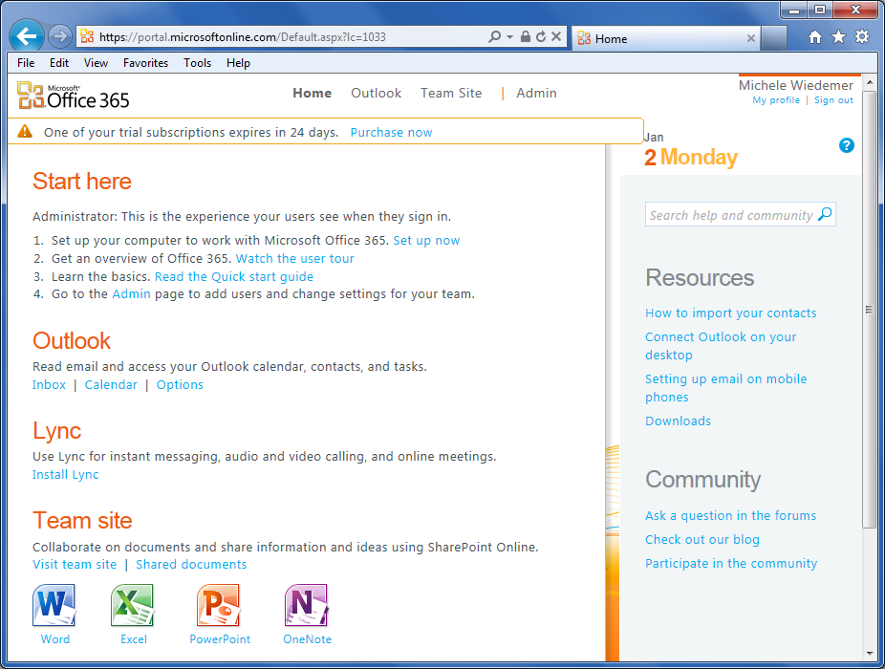
The Home Page
Team Site links
Shared Documents link
Office Web Apps Launchpad
Notes:
To sign into the Home Page, use the following procedure.
1. Open your web browser to the page: https://portal.microsoftonline.com/admin/default.aspx.
2. Enter your User ID and Password. You should have received an email from Microsoft or your administrator containing this information.
3. Check the Remember Me box if you are using your own computer and you want the computer to remember your User ID.
4. Check the Keep me signed in box if you are using your own computer and you want to skip the sign in page on future visits.
5. Select Sign In.
Note that you don’t want to use the Remember Me or Keep Me Signed In options if you are using a shared computer, as this will potentially allow others access to your files.

Slide 6
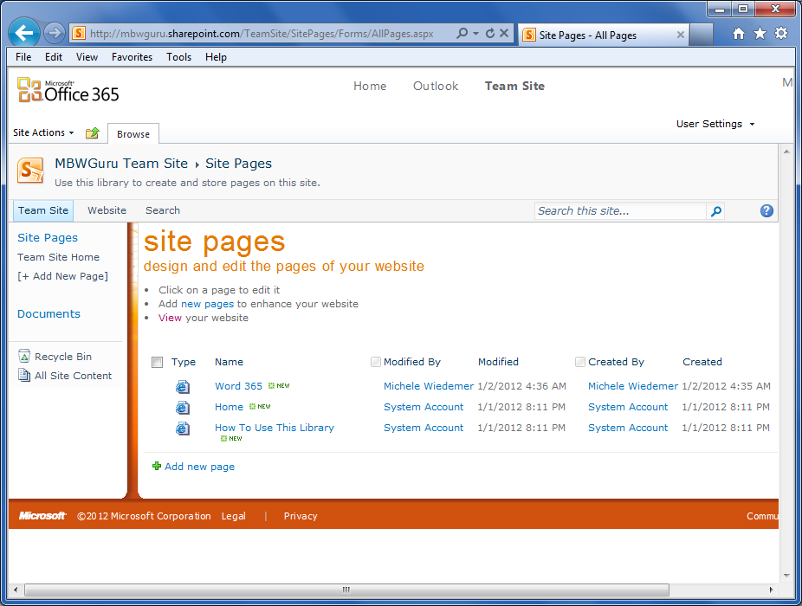
The Team Site
Notes:
The Team Site includes some SharePoint tools, which you do not need to understand to be able to use the Word Web App.
The important features are the Site Pages list on the left, and the posts on the right.
The Share this site link is the way you can invite anyone to view your documents, regardless of whether they are part of your team or not. To invite a visitor to the site, use the following procedure.
1. Select the Share this site link.
2. Enter the email address for the people that you want to invite to see the site (and the documents stored there). Visitors are people outside of your organization. They don’t even need to have an Office 365 account. Members are other members of your team.
3. Enter a Message to explain your invitation, if desired.
4. Select Share.

Slide 7
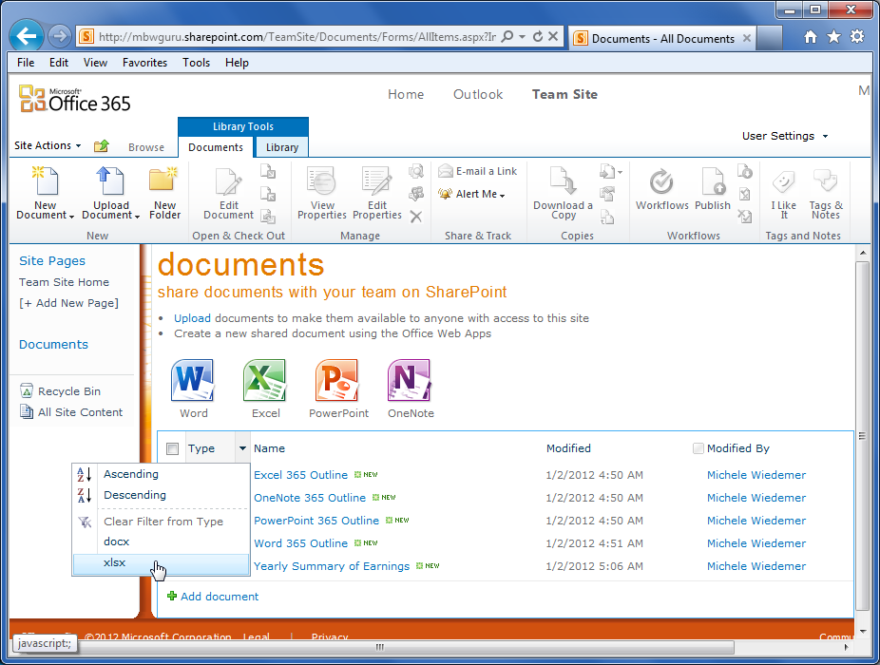
Shared Documents
Select the heading you want to use for the sort.
When you click on the heading, an arrow appears on the right hand side.
You can also filter the Documents list.
Notes:
Select the Documents link on the left side of the Team Site to open the Documents list.
The Documents list includes any files that anyone in your team has uploaded to the list.
To sort the list, use the following procedure.
1. Select the heading you want to use for the sort. In this example, we’ll sort by Name, which is the name of the file.
2. When you click on the heading, an arrow appears on the right hand side. You also see a context menu, where you can select your sorting preference.
3. You can also filter the Documents list. If you select the Type, Modified, or Modified By columns, you will see filtering options, based on what documents are in your list.
The filter icon next to the column heading indicates that the list has been filtered. Select the column again to see the list for removing the filter. Select Clear Filter From to remove the filter.

Slide 8
Uploading a Document
From the Shared Documents list, select the Add Document link.
Select Browse.
Navigate to the location of the file on your computer or network and select Open.
Check the Overwrite existing files box if you want any changes you make to overwrite the existing file. Select OK.
Notes:
1. From the Shared Documents list, select the Add Document link.
2. Select Browse.
3. Navigate to the location of the file on your computer or network and select Open.
4. Check the Overwrite existing files box if you want any changes you make to overwrite the existing file. If you do not want to overwrite the file, make sure you uncheck this box.
5. Select OK.
To upload multiple files, use the following procedure.
1. From the Shared Documents list, select the Upload link.
2. The easiest way to drag and drop multiple files is to open Windows Explorer to the folder containing the files you want to upload.
The cursor changes to a plus sign. Just drop the file icons onto the dialog box.
3. Check the Overwrite existing files box if you want any changes you make to overwrite the existing files. If you do not want to overwrite the files, make sure you uncheck this box.
4. Select OK.

Slide 9
Module Two: Review Questions
1. What is the first step to accessing the Office 365 web apps?
  Open Office 365 on your desktop.
  Sign in to the Microsoftonline portal.
  Go to your Company’s public facing website.
  Select the web app from the Team Site.
2. You should use Remember Me and Keep Me Signed in on a shared computer to protect your information.
  True
  False
3. The Team Site allows you to post messages to your team.
  True
  False
4. Does a person need to be on your Team to view your documents?
Yes
No, not if you’ve sent an invitation to share the site with them

Slide 10
Module Two: Review Questions
5. You can sort the documents list by Type, Name, Modified date and time, and Modified By author.
  True
  False
6. You can filter the documents list by Type, Name, Modified Date and time, and Modified by author.
  True
  False: You cannot filter by name.
7. You can upload by which of the following?
  Browsing, using a Choose File to Upload dialog box.
  Dragging and dropping, using Windows Explorer to drag in the documents.
  All of the above.
  None of the above.

Slide 11
Module Two: Review Questions
1. What is the first step to accessing the Office 365 web apps?
  Open Office 365 on your desktop.
  Sign in to the Microsoftonline portal.
  Go to your Company’s public facing website.
  Select the web app from the Team Site.
2. You should use Remember Me and Keep Me Signed in on a shared computer to protect your information.
  True
  False
3. The Team Site allows you to post messages to your team.
  True
  False
4. Does a person need to be on your Team to view your documents?
Yes
No, not if you’ve sent an invitation to share the site with them

Slide 12
Module Two: Review Questions
5. You can sort the documents list by Type, Name, Modified date and time, and Modified By author.
  True
  False
6. You can filter the documents list by Type, Name, Modified Date and time, and Modified by author.
  True
  False: You cannot filter by name.
7. You can upload by which of the following?
  Browsing, using a Choose File to Upload dialog box.
  Dragging and dropping, using Windows Explorer to drag in the documents.
  All of the above.
  None of the above.

Slide 13
Module Three: Viewing Web App Documents (I)
Quick Tip: You can access your Word document from any device with a browser: smart phones, tablets, or computers
First, you’ll learn how to open a document for review and get an overview of the Reading View. You’ll learn how to page through your document and print it from the Reading View. You’ll also learn how to find text. Finally, this module explains how to close a document without closing the Word web app.

Slide 14
Opening a Document
From the Shared Documents list, select the document you want to open.
You can also click the arrow to the right of the document name to see a list of options. Select View in Browser to open the Reading View.
Notes:
1. From the Shared Documents list, select the document you want to open.
You can also click the arrow to the right of the document name to see a list of options. Select View in Browser to open the Reading View.

Slide 15
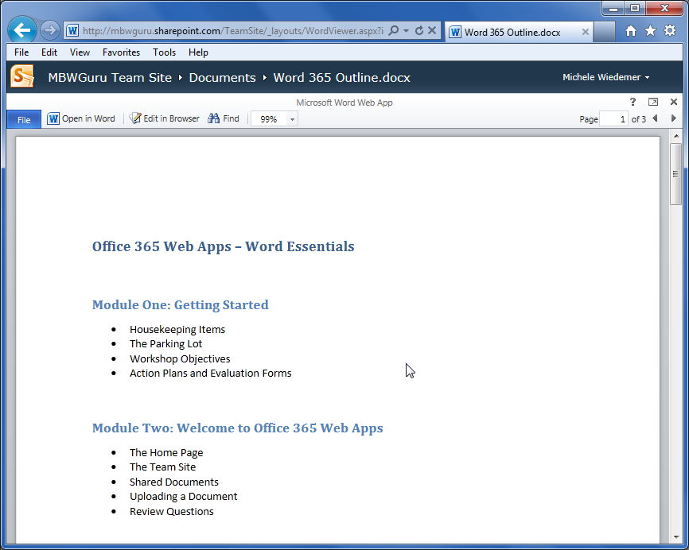
Overview of the Reading View
Links for the Team Site and the Shared Documents list
A simplified “Ribbon” with a few basic commands
Options for the user who is signed into Office 365
The document contents
Notes:
The top of the screen includes links to return to the Team Site and the Shared Documents list. At the right side of this top banner, your user name is listed. There is an arrow to the right of your user name. You can select this arrow to see a list of options for managing your user account.
In the Reading View, there are only a few commands available. The Ribbon of commands is below the banner with the links for your team site and the shared documents list. We’ll talk about how to do each of these items later in this module and in the next module.
The main portion of the screen is the document view.

Slide 16
Paging Through Documents
Select Next Page to move to the top of the next page in the document.
Select Previous Page to move to the top of the previous page in the document.
You can also enter a page number to jump directly to that page. Type the number in the Page box and press Enter.
Notes:
To use the navigation commands on the Ribbon, use the following procedure.
1. Select Next Page to move to the top of the next page in the document.
2. Select Previous Page to move to the top of the previous page in the document.
3. You can also enter a page number to jump directly to that page. Type the number in the Page box and press Enter.

Slide 17
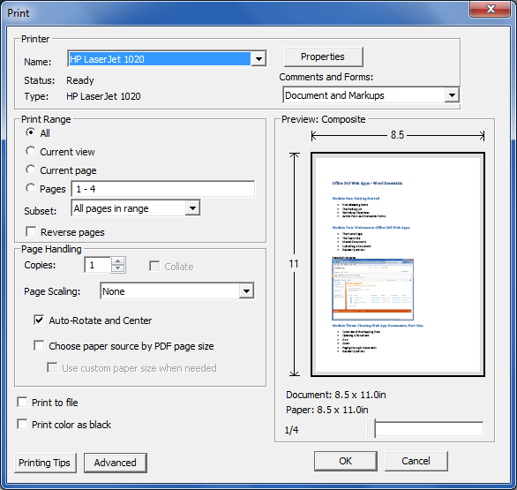
Printing From the Reading View
Select the File tab.
Select Print.
The standard Print dialog box opens. Adjust the printer, print range, page handling, and other settings as necessary and select OK.
Notes:
1. Select the File tab.
2. Select Print.
3. The standard Print dialog box opens. Adjust the printer, print range, page handling, and other settings as necessary and select OK.

Slide 18
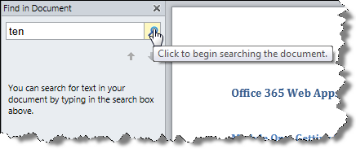
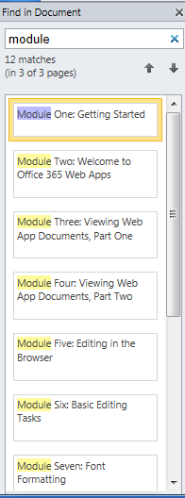
Finding Text in Your Document
Notes:
1. Select the Find command on the Ribbon.
2. The Find in Document pane opens on the left side of the screen.
3. Enter the text you want to find.
4. Select the Magnifying glass icon to begin the search.
5. The Find in Document pane displays a selection of text from the paragraphs that include the search text. You can use the up and down arrows to navigate through the list. You can also click on the listing to jump to that location in the document.
6. Select the X next to the search term to begin a new search.
7. Select the X next to Find in Document to close the search pane.

Slide 19

Closing Documents
Click the X in the top right portion of the screen.
The browser returns to the Shared Documents list on your Team Site.
Notes:
1. Click the X in the top right portion of the screen (next to the Help icon and the Pop Out icon).
2. The browser returns to the Shared Documents list on your Team Site.

Slide 20
Module Three: Review Questions
1. You can make changes to a document in the Reading View.
  True
  False
2. You open a document in the Word web app from which of the following:
  The Shared Documents list
  Your computer’s hard drive
  The Microsoft.com web site
  The Office 365 Home page
3. What links are available at the top of the Reading View?
  The Team Site
  The Shared Documents List
  A and B
  None of the above
4. What are three ways to navigate through your document?

Slide 21
Module Three: Review Questions
5. Where can you find the print command in the Reading View?
  Next to the Help icon
  Next to the Page Navigation icons
  In the File tab
  You must open in Word 2010 to print
6. What do you select to begin a search?
  The Zoom drop down list
  Your user name
  The Page box
  The Find icon
7. What does clicking the X next to a search term do?
  Closes the Find in Document pane
  Clears the search term, but allows you to start a new search
  Closes the Reading View
  Closes the Web app
8. When you close a web app document, the browser returns to the Shared Documents list on your Team Site.
  True
  False

Slide 22
Module Three: Review Questions
9. Closing the browser is the only way to close a web app document.
  True
  False

Slide 23
Module Three: Review Questions
1. You can make changes to a document in the Reading View.
  True
  False
2. You open a document in the Word web app from which of the following:
  The Shared Documents list
  Your computer’s hard drive
  The Microsoft.com web site
  The Office 365 Home page
3. What links are available at the top of the Reading View?
  The Team Site
  The Shared Documents List
  A and B
  None of the above
4. What are three ways to navigate through your document? (The scroll bar, the page up and page down keys, and the previous page/next page/page box icons on the Ribbon)

Slide 24
Module Three: Review Questions
5. Where can you find the print command in the Reading View?
  Next to the Help icon
  Next to the Page Navigation icons
  In the File tab
  You must open in Word 2010 to print
6. What do you select to begin a search?
  The Zoom drop down list
  Your user name
  The Page box
  The Find icon
7. What does clicking the X next to a search term do?
  Closes the Find in Document pane
  Clears the search term, but allows you to start a new search
  Closes the Reading View
  Closes the Web app
8. When you close a web app document, the browser returns to the Shared Documents list on your Team Site.
  True
  False

Slide 25
Module Three: Review Questions
9. Closing the browser is the only way to close a web app document.
  True
  False

Slide 26
Module Four: Viewing Web App Documents (II)
I am not ashamed to confess I am ignorant of what I do not know.
Marcus Tullius Cicero
We’ll discuss the conversion process for opening certain types of documents. When we look at the Editing View (in the next module), you’ll see that you can only perform certain types of edits in the web app. In this module, you’ll learn how to open the document in Word from the Reading View so that you can use the more advanced features of Office 2010 Professional to polish your document.
Notes:
In this module, we continue working with the Reading View. First, you’ll learn how to change your view by zooming or using the Pop out. Next, you’ll learn how to open a document for editing in the browser. We’ll discuss the conversion process for opening certain types of documents. When we look at the Editing View (in the next module), you’ll see that you can only perform certain types of edits in the web app. In this module, you’ll learn how to open the document in Word from the Reading View so that you can use the more advanced features of Office 2010 Professional to polish your document.

Slide 27
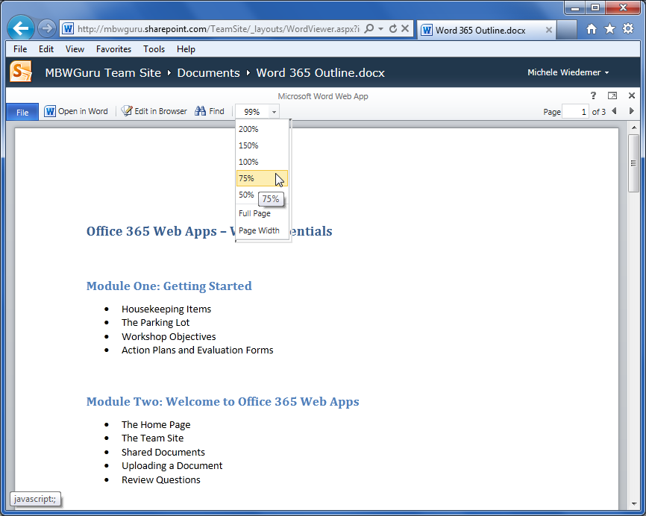
Zooming in your Document
Notes:
To adjust the zoom level in the Reading View, use the following procedure.
1. To select one of the present zoom levels, select the arrow next to the 100% on the Ribbon.
2. Select an option from the drop down list.
• 200%
• 150%
• 100%
• 75%
• 50%
• Full Page (based on the size of your window, but shows the full page top to bottom)
• Page Width (based on the size of your window, but shows the full page left to right)

Slide 28
Using the Pop Out
The Pop Out command sits between the question mark icon and the X icon on the top right portion of the screen. Click the Pop Out command.
The document opens in a separate window. Now you have a little more room, top to bottom, for viewing your document.
Notes:
To use the Pop Out command, use the following procedure.
1. The Pop Out command sits between the question mark icon and the X icon on the top right portion of the screen. Click the Pop Out command.
2. The document opens in a separate window. Now you have a little more room, top to bottom, for viewing your document.

Slide 29

Editing in Browser
Select the Edit in Browser option from the Ribbon.
The document has to reload. Then the Word web app displays the document in editing view.

Slide 30
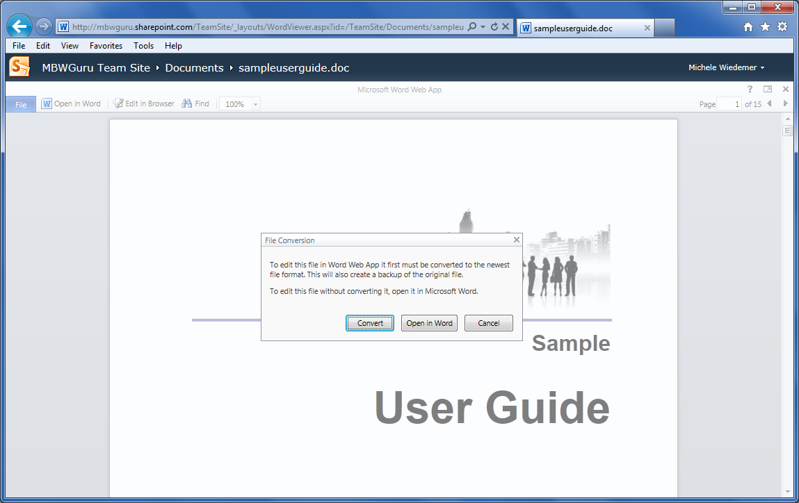
About Converting Documents
If the document you are opening requires conversion, the Word web app will display the following message.
Notes:
If the document you are opening requires conversion, the Word web app will display the following message.
Select Convert.
If Word had to make changes to the layout during the conversion process, you will see the following message.
Select View to open the document in the Reading View. Select Edit to open the document in the editing view.
Note that you will now have an additional file on your Shared Documents list for the converted file.

Slide 31
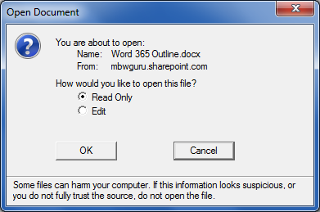
Opening in Word
Select the Open in Word option from the Ribbon.
You will receive an Open Document message, as illustrated below. Select whether to open the document as Read Only or with Edit capabilities. Then select OK.
Notes:
To open a document in Word 2010, use the following procedure.
1. Select the Open in Word option from the Ribbon.
2. You will receive an Open Document message, as illustrated below. Select whether to open the document as Read Only or with Edit capabilities. Then select OK.
3. The Office 365 Sign in page appears. You need to sign in again, even though you’ve signed into the site through the browser. This will establish the connection with your desktop application as well. Click below your user name, enter your password, and select Sign In.
4. Word 2010 opens with your document loaded. It may take a few moments, depending on your internet connection speed. You will see a yellow Protected View message at the top.
5. Click Enable Editing to begin working with the document.
Select the Open in Word option from the Ribbon.
You will receive an Open Document message, as illustrated below. Select whether to open the document as Read Only or with Edit capabilities. Then select OK.

Slide 32
Module Four: Review Questions
1. You can make changes to a document in the Reading View.
  True
  False
2. You open a document in the Word web app from which of the following:
  The Shared Documents list
  Your computer’s hard drive
  The Microsoft.com web site
  The Office 365 Home page
3. What links are available at the top of the Reading View?
  The Team Site
  The Shared Documents List
  A and B
  None of the above
4. What are three ways to navigate through your document?

Slide 33
Module Four: Review Questions
5. Where can you find the print command in the Reading View?
  Next to the Help icon
  Next to the Page Navigation icons
  In the File tab
  You must open in Word 2010 to print
6. What do you select to begin a search?
  The Zoom drop down list
  Your user name
  The Page box
  The Find icon
7. What does clicking the X next to a search term do?
  Closes the Find in Document pane
  Clears the search term, but allows you to start a new search
  Closes the Reading View
  Closes the Web app
8. When you close a web app document, the browser returns to the Shared Documents list on your Team Site.
  True
  False

Slide 34
Module Four: Review Questions
9. Closing the browser is the only way to close a web app document.
  True
  False

Slide 35
Module Four: Review Questions
1. You can make changes to a document in the Reading View.
  True
  False
2. You open a document in the Word web app from which of the following:
  The Shared Documents list
  Your computer’s hard drive
  The Microsoft.com web site
  The Office 365 Home page
3. What links are available at the top of the Reading View?
  The Team Site
  The Shared Documents List
  A and B
  None of the above
4. What are three ways to navigate through your document? (The scroll bar, the page up and page down keys, and the previous page/next page/page box icons on the Ribbon)

Slide 36
Module Four: Review Questions
5. Where can you find the print command in the Reading View?
  Next to the Help icon
  Next to the Page Navigation icons
  In the File tab
  You must open in Word 2010 to print
6. What do you select to begin a search?
  The Zoom drop down list
  Your user name
  The Page box
  The Find icon
7. What does clicking the X next to a search term do?
  Closes the Find in Document pane
  Clears the search term, but allows you to start a new search
  Closes the Reading View
  Closes the Web app
8. When you close a web app document, the browser returns to the Shared Documents list on your Team Site.
  True
  False

Slide 37
Module Four: Review Questions
9. Closing the browser is the only way to close a web app document.
  True
  False

Slide 38
Module Five: Editing in the Browser
Never underestimate the power of dreams and the influence of the human spirit. We are all the same in this notion: The potential for greatness lives within each of us.
Wilma Rudolph
First, we’ll look at starting a new document from the Home Page. Then, you’ll learn about saving files through the Web app. We’ll take a closer look at the Word Web app interface. The rest of the module will explain how to add text, select text with the mouse or keyboard, and edit or delete text.

Slide 39
A New File
From the Home page on your SharePoint site, click on the Word icon.
Enter a File Name for the new document and select OK.
The document opens in the Editing View.
Notes:
1. From the Home page on your SharePoint site, click on the Word icon.
2. Enter a File Name for the new document and select OK.
3. The document opens in the Editing View.

Slide 40
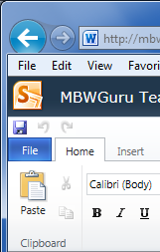
Saving Files
The Quick Access Save command is at the top left of the screen (under the banner).
Save icon
Notes:
You’ll see a “Saving” box flash in the middle of the screen while your changes are saved and uploaded to the Team Site.

Slide 41
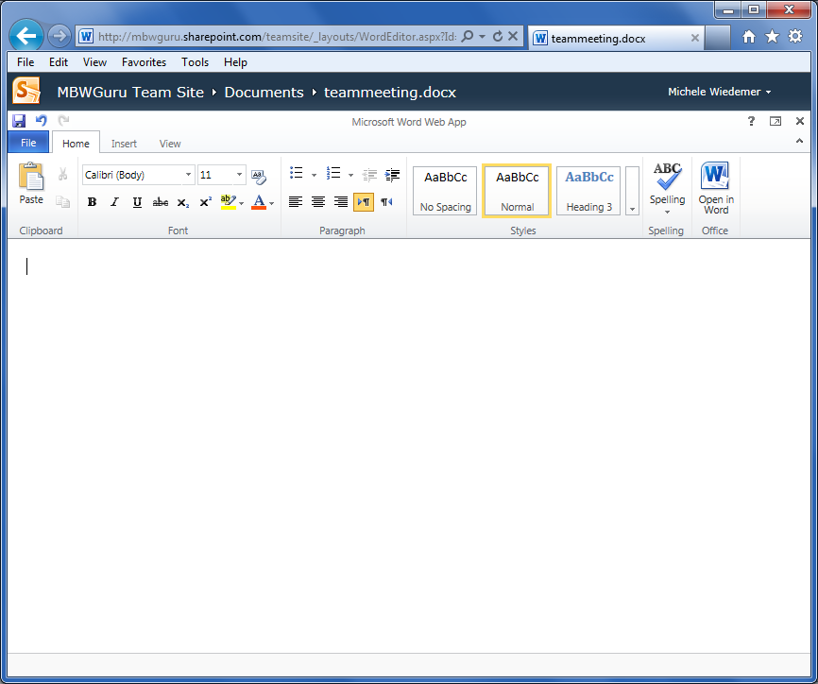
The Word Web App Interface
Save, Undo, and Redo commands
Ribbon
Document window

Slide 42
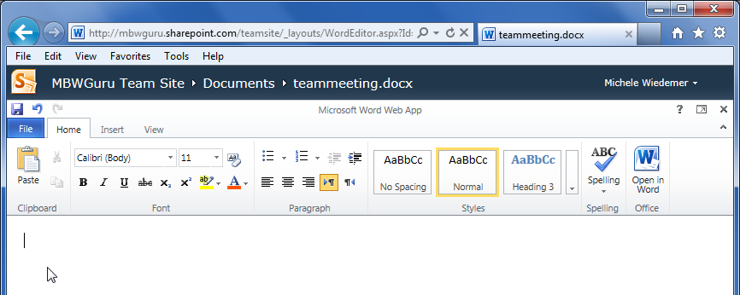
Typing Text
Note that in the Web app, the mouse pointer does not change.
Notes:
Notice that once you type a 1 with a period and a space, the Word web app assumes that you are making a list, and the remaining numbers do not need to be entered

Slide 43
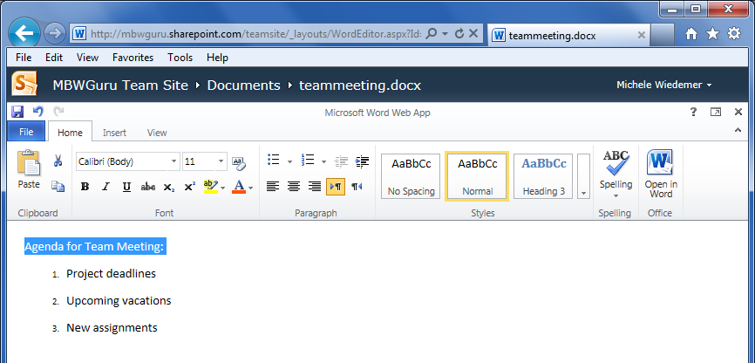
Selecting Text with the Mouse or Keyboard
Using the arrow keys, place the cursor either at the beginning of the text you want to select, or at the end of the text you want to select.
Hold down the shift key while pressing the arrow key to select text in that direction.
Notes:
To use the keyboard to select text, use the following procedure.
1. Using the arrow keys, place the cursor either at the beginning of the text you want to select, or at the end of the text you want to select.
2. Hold down the shift key while pressing the arrow key to select text in that direction.
The selected text is highlighted in blue.
To use the mouse to select text, use the following procedure.
1. Point the mouse to either the beginning or the end of the text you want to select.
2. Hold the left mouse button down.
3. Move the mouse to select the text. You can move left, right, up and/or down.
4. Let the mouse button up when you have finished selecting the text.
The mouse shortcuts for selecting text.
• You can double click on a word to select it.
• You can press Shift while clicking to add to your selection. The selections must be next to each other.
Note that the other keyboard shortcuts for selecting text that are available in Word 2010 are not available in the web app.

Slide 44
Module Four: Review Questions
1. The Zoom command helps you find text in your document.
  True
  False
2. Which of the following is not a zoom option?
  50%
  200%
  Custom percentages
  All of these are zoom options
3. The Pop Out allows you to perform some edits, such as a spell check.
  True
  False
4. The Edit in Browser command can be found on the File tab.
  True
  False

Slide 45
Module Four: Review Questions
5. he Edit in Browser view looks exactly the same as the Reading View.
  True
  False
6. Why would you need to open a web app document in Word 2010?
7. You need to sign in again when opening a document in Word 2010.
  True
  False
8. When you save a web app document that you have opened in Word 2010, the save command also updates the document on the shared documents site.
  True
  False

Slide 46
Module Four: Review Questions
1. The Zoom command helps you find text in your document.
  True
  False
2. Which of the following is not a zoom option?
  50%
  200%
  Custom percentages
  All of these are zoom options
3. The Pop Out allows you to perform some edits, such as a spell check.
  True
  False
4. The Edit in Browser command can be found on the File tab.
  True
  False

Slide 47
Module Four: Review Questions
5. he Edit in Browser view looks exactly the same as the Reading View.
  True
  False
6. Why would you need to open a web app document in Word 2010? (Because there are some editing tools that are not available when editing in the browser.)
7. You need to sign in again when opening a document in Word 2010.
  True
  False
8. When you save a web app document that you have opened in Word 2010, the save command also updates the document on the shared documents site.
  True
  False

Slide 48
Module Six: Basic Editing Tasks
You write to communicate to the hearts and minds of others what's burning inside you. And we edit to let the fire show through the smoke.
Arthur Polotnik
This module covers how to cut, copy, and paste text. It explains how to undo and redo tasks, as well as how to check your spelling. You can change the proofing language from the Editing view. You’ll learn how to print from the Editing view

Slide 49
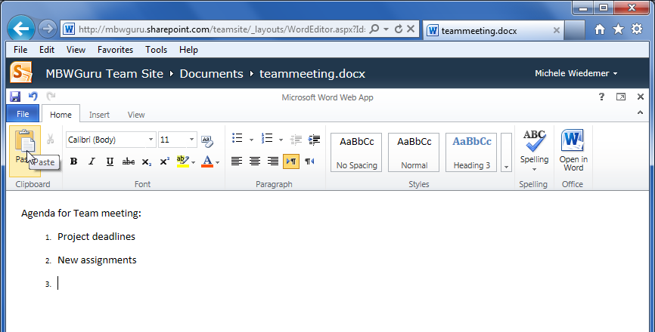
Using Cut, Copy, and Paste
Highlight the text you want to cut.
Select the Cut command from the Ribbon (or use the Ctrl + X keyboard shortcut).
Move the cursor to the new location.
Select the Paste icon from the Ribbon (or use the Ctrl + V keyboard shortcut).
Notes:
To cut and paste text, use the following procedure.
1. Highlight the text you want to cut.
2. Select the Cut command from the Ribbon (or use the Ctrl + X keyboard shortcut).
3. Move the cursor to the new location.
4. Select the Paste icon from the Ribbon (or use the Ctrl + V keyboard shortcut).
To copy and paste text using the keyboard shortcuts, use the following procedure.
1. Highlight the text you want to copy and press the Control key and the C key at the same time.
2. Move the cursor to the new location.
3. Press the Control key and the V key at the same time.

Slide 50
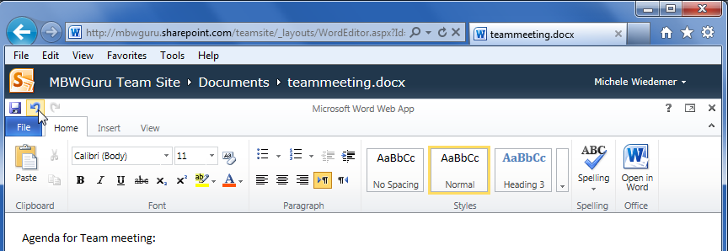
Using Undo and Redo
Select the Undo command from the top of the Ribbon

Slide 51
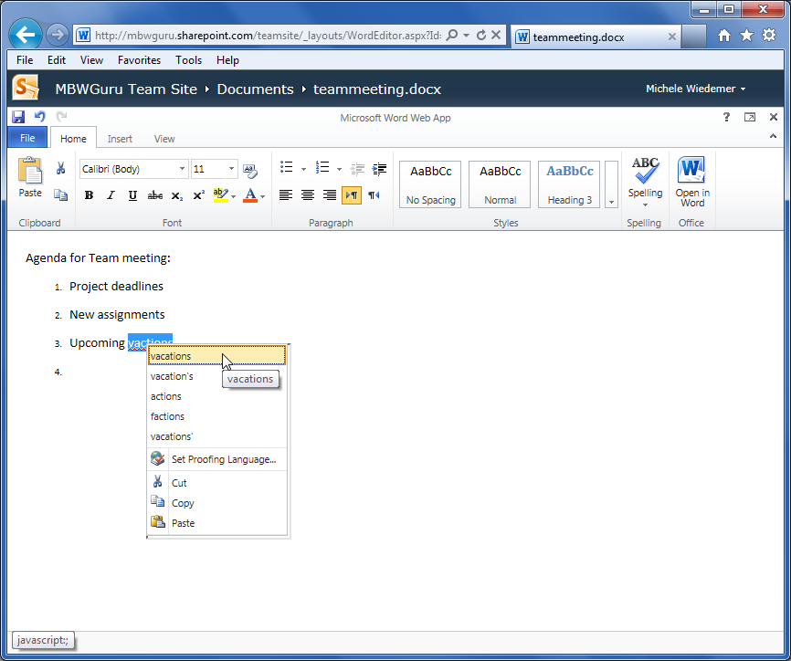
Checking Your Spelling
Right click on a misspelled word to display the context menu.
Notes:
1. Right click on a misspelled word to display the context menu.
To use the Spelling command from the Ribbon, use the following procedure.
1. Select SPELLING from the Ribbon.
The Word web app highlights the first suspect word in the document, with the context menu of possible corrections displayed.
Select the correction from the list. You’ll need to select the Spelling tool again to continue the spell check.

Slide 52
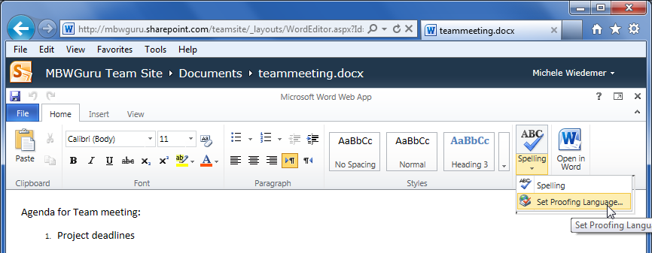
Setting the Proofing Language
Select the Spelling command from the Ribbon.
Select Set Proofing Language.
Select the language you want to use from the Language dialog box and select OK.

Slide 53
Printing from the Editing View
Select the File tab.
Select Print.
If you haven’t saved your document, you’ll see the following message. Select Save and Print to continue.
The standard Print dialog box opens. Adjust the printer, print range, page handling, and other settings as necessary and select OK.

Slide 54
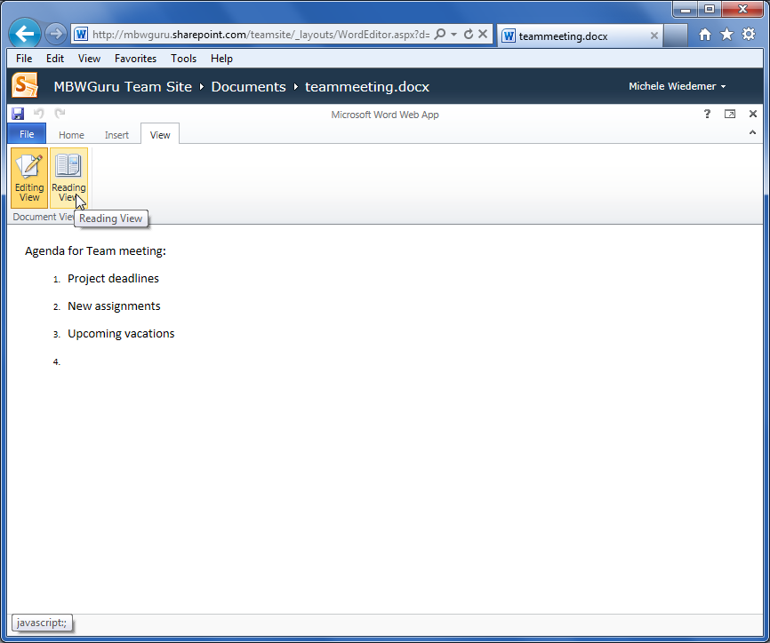
Accessing the Reading View
Select the View tab from the Ribbon.
Select Reading View.

Slide 55
Module Six: Review Questions
1. What is the difference between cut and copy?
  Cutting removes the text from the current location, while copying allows you to reuse the selected text without removing it.
  Cutting includes the text at the cursor’s current location, while copying allows you to reuse the selected text without removing it.
  A and B
  None of the above
2. What is the keyboard shortcut for pasting?
  Ctrl + C
  Ctrl + V
  Ctrl + S
  Ctrl + X
3. The Undo and Redo commands are available on the File tab.
  True
  False
4. The Word web app checks your spelling as you type.
  True
  False

Slide 56
Module Six: Review Questions
5. The context menu and the Spelling command both provide possible corrections for spelling errors.
  True
  False
6. The Proofing language tells Word which language to use for the spell check.
  True
  False
7. You can print from the Editing view without saving your changes.
  True
  False
8. You access the Reading View from the View menu.
  True
  False

Slide 57
Module Six: Review Questions
1. What is the difference between cut and copy?
  Cutting removes the text from the current location, while copying allows you to reuse the selected text without removing it.
  Cutting includes the text at the cursor’s current location, while copying allows you to reuse the selected text without removing it.
  A and B
  None of the above
2. What is the keyboard shortcut for pasting?
  Ctrl + C
  Ctrl + V
  Ctrl + S
  Ctrl + X
3. The Undo and Redo commands are available on the File tab.
  True
  False
4. The Word web app checks your spelling as you type.
  True
  False

Slide 58
Module Six: Review Questions
5. The context menu and the Spelling command both provide possible corrections for spelling errors.
  True
  False
6. The Proofing language tells Word which language to use for the spell check.
  True
  False
7. You can print from the Editing view without saving your changes.
  True
  False
8. You access the Reading View from the View menu.
  True
  False

Slide 59
Module Seven: Font Formatting
Information is a source of learning. But unless it is organized, processed, and available to the right people in a format for decision making, it is a burden, not a benefit.
William Pollard
The Word web app allows you to enhance your text in many ways. In this module, we’ll discuss the different types of formatting, as well as cover the most basic types of formatting your words. This includes the font face, size, and color, as well as enhancing the text and adding text effects.

Slide 60
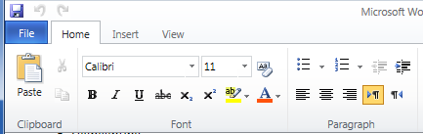
Understanding Levels of Formatting
The Font and Paragraph groups on the Home tab of the Ribbon.

Slide 61
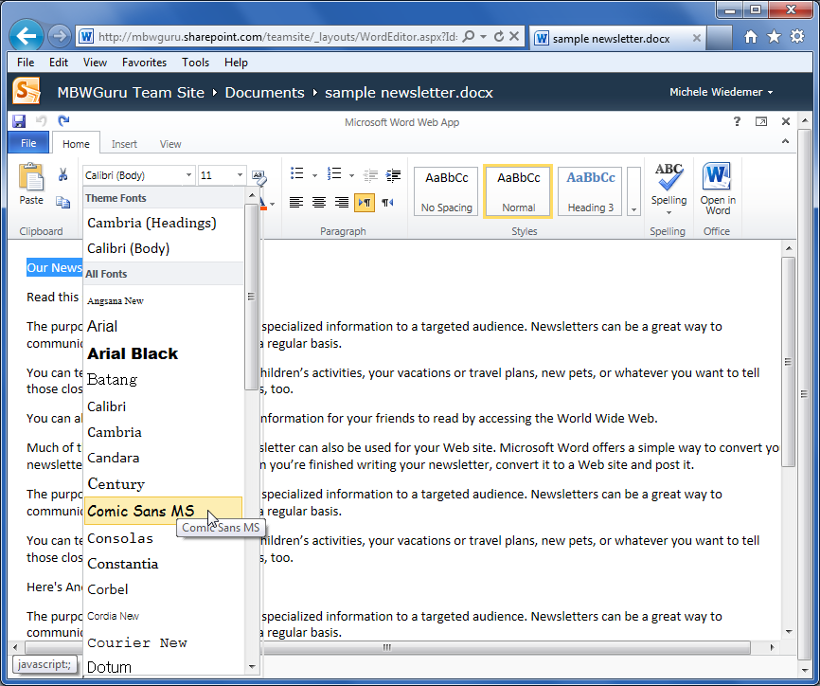
Changing Font Face and Size
Notes:
1. Select the text you want to change.
2. Select the arrow next to the current font name to display the list of available fonts.
3. Use the scroll bar or the down arrow to scroll down the list of fonts.
4. Select the desired font to change the font of text.
5. With the text still selected, select the arrow next to the current font size to see a list of common font sizes.
6. Use the scroll bar or the down arrow key to scroll to the size you want and select it. You can also highlight the current font size and type in a new number to indicate the font size you want.

Slide 62
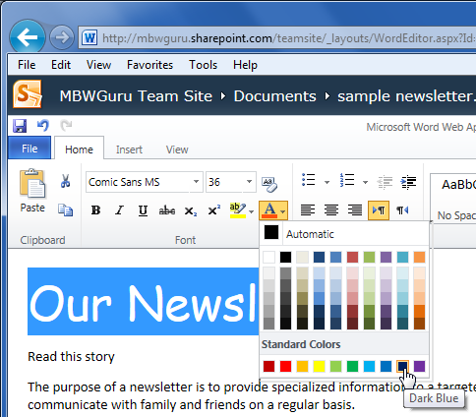
Changing the Font Color
Notes:
1. Select the text you want to change.
2. Select the arrow next to the Font Color tool on the Ribbon to display the gallery.
3. Select the color to change the font color.

Slide 63
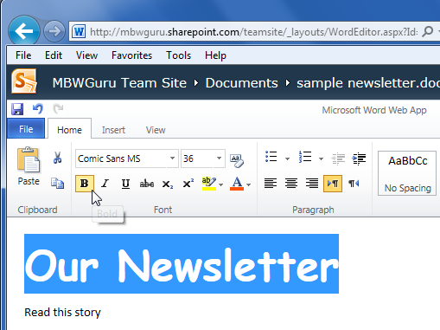
Adding Font Enhancements
Select the text you want to change.
Select the Bold tool from the Ribbon.
Notes:
1. Select the text you want to change.
2. Select the Bold tool from the Ribbon.

Slide 64
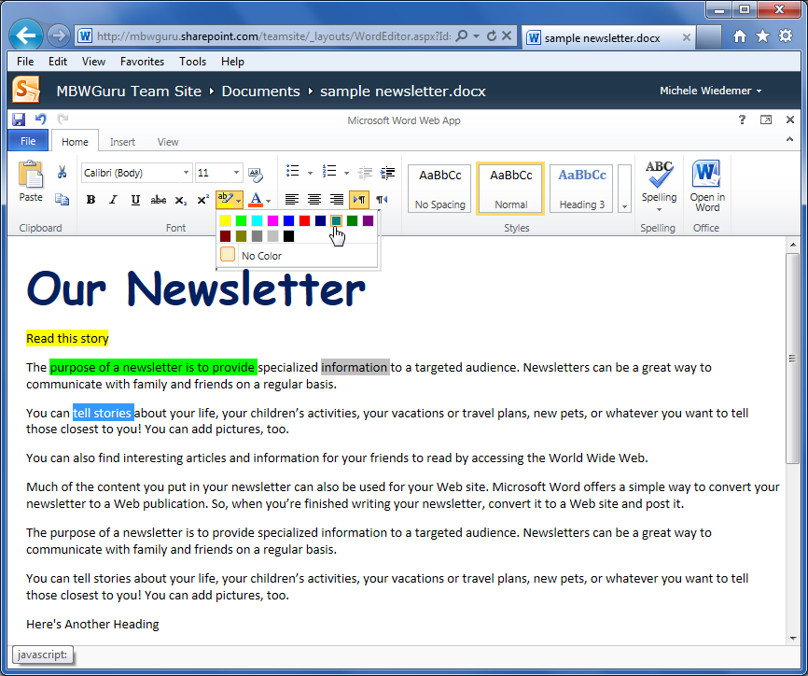
Highlighting Text
Select the text you want to highlight.
Select the Text Highlight tool from the Ribbon.
Select the highlighting color.

Slide 65
Module Seven: Review Questions
1. What is the difference between font formatting and paragraph formatting?
  Font formatting changes the look and feel of the text at the letter or word level and paragraph formatting changes the look and feel of the text for the whole paragraph.
  Paragraph formatting changes the look and feel of the text at the letter or word level and font formatting changes the look and feel of the text for the whole paragraph.
2. Which of the following is NOT a font formatting option?
  Face
  Alignment
  Enhancements (like bold and underline)
  Color
3. Which fonts are listed first in the Font Face list?
  All fonts on your computer in alphabetical order
  Theme fonts
  Most recently used fonts
  None of the above
4. What typography unit of measure is used for font sizes?
  Millimeters
  Nanometers
  Ounces
  Points

Slide 66
Module Seven: Review Questions
5. What color is used for the Automatic font color?
  Blue
  Black
  White
  Red
6. Which font enhancement crosses text out?
  Subscript
  Italics
  Bold
  Strikeout
7. You can select the highlighter color before selecting your text to be highlighted.
  True
  False

Slide 67
Module Seven: Review Questions
1. What is the difference between font formatting and paragraph formatting?
  Font formatting changes the look and feel of the text at the letter or word level and paragraph formatting changes the look and feel of the text for the whole paragraph.
  Paragraph formatting changes the look and feel of the text at the letter or word level and font formatting changes the look and feel of the text for the whole paragraph.
2. Which of the following is NOT a font formatting option?
  Face
  Alignment
  Enhancements (like bold and underline)
  Color
3. Which fonts are listed first in the Font Face list?
  All fonts on your computer in alphabetical order
  Theme fonts
  Most recently used fonts
  None of the above
4. What typography unit of measure is used for font sizes?
  Millimeters
  Nanometers
  Ounces
  Points

Slide 68
Module Seven: Review Questions
5. What color is used for the Automatic font color?
  Blue
  Black
  White
  Red
6. Which font enhancement crosses text out?
  Subscript
  Italics
  Bold
  Strikeout
7. You can select the highlighter color before selecting your text to be highlighted.
  True
  False

Slide 69
Module Eight: Formatting Paragraphs
Nothing is more fleeting than external form, which withers and alters like the flowers of the field at the appearance of autumn.
Umberto Eco
Paragraph formatting controls the look and feel of an entire paragraph. In this module, we’ll discuss how to set the alignment and use tabs and indents. We’ll also practice using bullets and numbering the document. Finally, we’ll take a look at the Text Direction commands.

Slide 70
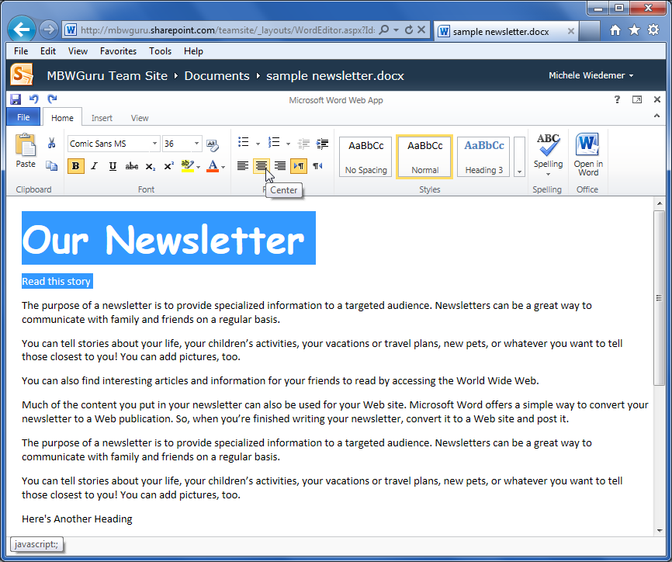
Setting the Alignment
Notes:
To adjust the alignment for the paragraph, use the following procedure.
With your cursor anywhere in the paragraph you want to adjust (the text does not have to be selected), select the desired alignment tool from the Ribbon. You can also select multiple paragraphs by selecting the text.

Slide 71
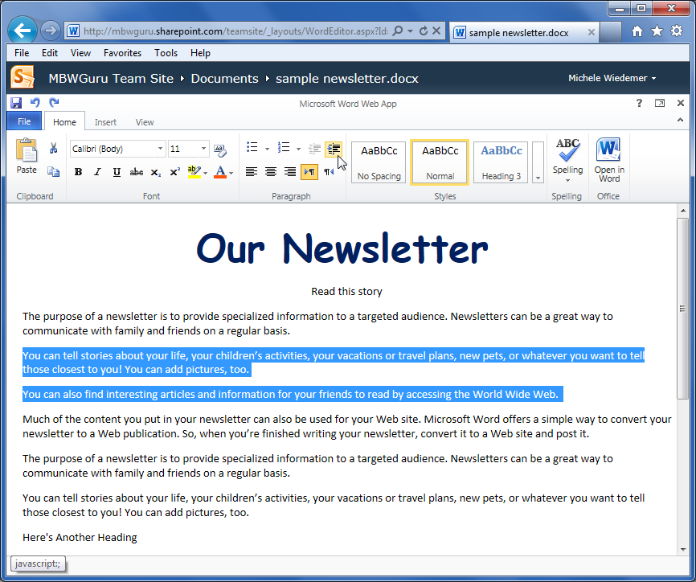
Using Indents and Tabs
Notes:
To add a whole paragraph indent, use the following procedure.
With your cursor anywhere in the paragraph you want to adjust (the text does not have to be selected), select the Indent tool from the Ribbon. You can also select multiple paragraphs by selecting the text.

Slide 72
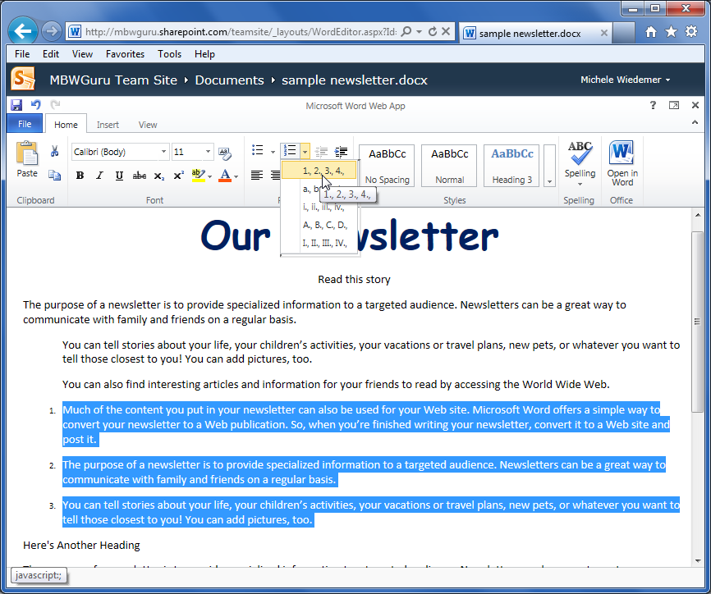
Adding Bullets and Numbering

Slide 73
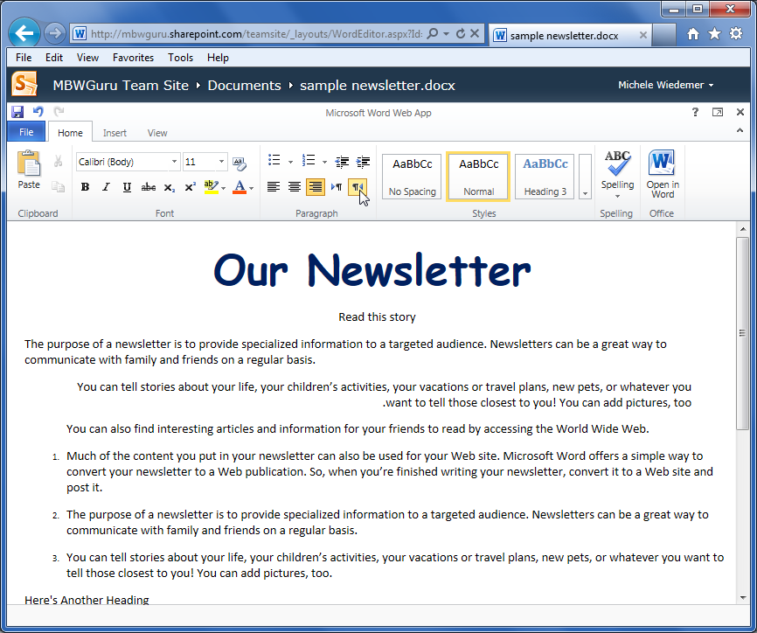
Text Direction
Notes:
Select the paragraphs for which you want to change the direction.
Select the appropriate Text Direction tool from the Ribbon.

Slide 74
Module Eight: Review Questions
1. Alignment is which of the following?
  Creating a grouping of formatting options to repeat for other text.
  Formatting the text to read right-to-left or left-to-right.
  Formatting the text to appear centered, lined up on the left margin or lined up on the right margin.
  The amount of space between lines or paragraphs.
2. You can create a first line indent by pressing the TAB key at the beginning of the paragraph.
  True
  False
3. The Indent commands indent all but the first line to create hanging indents.
  True
  False
4. You have to select the text for a paragraph to create an indent.
  True
  False

Slide 75
Module Eight: Review Questions
5. Which of the following is NOT one of the bullet options?
  Square
  Hollow
  Solid
  Custom
6. You can choose where to start your numbered list.
  True
  False
7. Which of the following is the Text direction command for right-to-left text?
  1
  2
  3
  4

Slide 76
Module Eight: Review Questions
1. Alignment is which of the following?
  Creating a grouping of formatting options to repeat for other text.
  Formatting the text to read right-to-left or left-to-right.
  Formatting the text to appear centered, lined up on the left margin or lined up on the right margin.
  The amount of space between lines or paragraphs.
2. You can create a first line indent by pressing the TAB key at the beginning of the paragraph.
  True
  False
3. The Indent commands indent all but the first line to create hanging indents.
  True
  False
4. You have to select the text for a paragraph to create an indent.
  True
  False

Slide 77
Module Eight: Review Questions
5. Which of the following is NOT one of the bullet options?
  Square
  Hollow
  Solid
  Custom
6. You can choose where to start your numbered list.
  True
  False
7. Which of the following is the Text direction command for right-to-left text?
  1
  2
  3
  4

Slide 78
Module Nine: Working with Styles
Harrow the house of the dead; look shining at / New styles of architecture, a change of heart.
W. H. Auden
Styles are a powerful formatting tool to take your Word web app document to the next level. Styles help provide consistency. They are also useful if you eventually want to use certain advanced features like generated tables of contents. This module introduces styles to help make your documents look great. You’ll also learn how to clear your formatting choices if you change your mind about them to easily return to the default formatting.

Slide 79
About Styles
They also help ensure that your document is consistently formatted.
Styles also provide an easy way to easily change the look of the whole document if styles have been applied appropriately.
Notes:
The implications of using styles may not be apparent in shorter documents, but they are a great time saver for longer documents. They also help ensure that your document is consistently formatted. Styles also provide an easy way to easily change the look of the whole document if styles have been applied appropriately.
Note that if the document will need a Table of Contents (which must be done in Word 2010), the headings will need to have styles applied for the TOC to be properly generated.

Slide 80
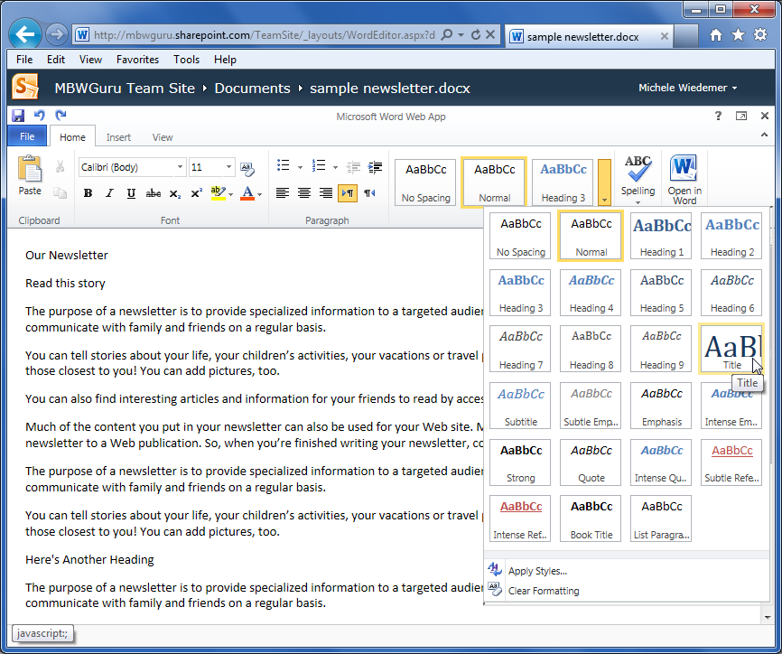
Quick Styles versus the Style Gallery
Notes:
To open the Apply Styles dialog box, use the following procedure.
Click the arrow next to the Styles group.
Select Apply Styles from the list.

Slide 81
Applying a Style
Select the text you want to format, or simply place your cursor in the word or paragraph you want to format (if you are selecting a paragraph style).
Open the Style Gallery by clicking the down arrow next to the styles shown in the Styles group.
Select the desired style to apply it to the current word or paragraph.
Notes:
To use the Style gallery to apply a paragraph or character style.
Select the text you want to format, or simply place your cursor in the word or paragraph you want to format (if you are selecting a paragraph style).
Open the Style Gallery by clicking the down arrow next to the styles shown in the Styles group.
Select the desired style to apply it to the current word or paragraph.

Slide 82
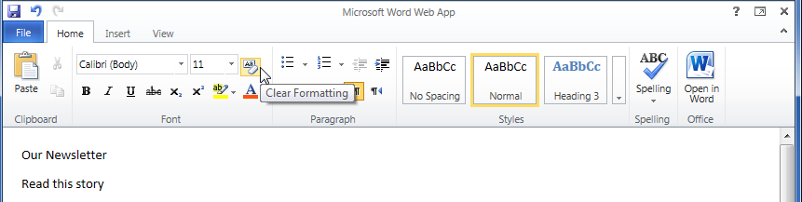
Clearing Formatting
Place the cursor in the paragraph whose formatting you want to clear.
Select the Clear Formatting tool.

Slide 83
Module Nine: Review Questions
1. Styles are only available for paragraph formatting.
  True
  False
2. Styles are only available for font formatting.
  True
  False
3. You can view the Style Gallery by clicking the arrow next to the Styles on the Ribbon.
  True
  False
4. You don’t need to select the text you want to format before selecting a character style.
  True
  False

Slide 84
Module Nine: Review Questions
5. You don’t need to select the text you want to format before selecting a paragraph style.
  True
  False
6. The Clear Formatting tool works the same as the Undo feature.
  True
  False (it clears ALL formatting from the text, not just the last action)

Slide 85
Module Nine: Review Questions
1. Styles are only available for paragraph formatting.
  True
  False
2. Styles are only available for font formatting.
  True
  False
3. You can view the Style Gallery by clicking the arrow next to the Styles on the Ribbon.
  True
  False
4. You don’t need to select the text you want to format before selecting a character style.
  True
  False

Slide 86
Module Nine: Review Questions
5. You don’t need to select the text you want to format before selecting a paragraph style.
  True
  False
6. The Clear Formatting tool works the same as the Undo feature.
  True
  False (it clears ALL formatting from the text, not just the last action)

Slide 87
Module Ten: The Insert Tools (I)
Ability is what you're capable of doing. Motivation determines what you do. Attitude determines how well you do it.
Lou Holtz
In this module and the next, we’ll take a closer look at the tools on the Insert tab. First, we’ll look at how to insert a table, as well as how to add text to a table. We’ll also take a look at the Table Tools tab that appears when you are working in a table. Then, you’ll learn how to insert a link.

Slide 88
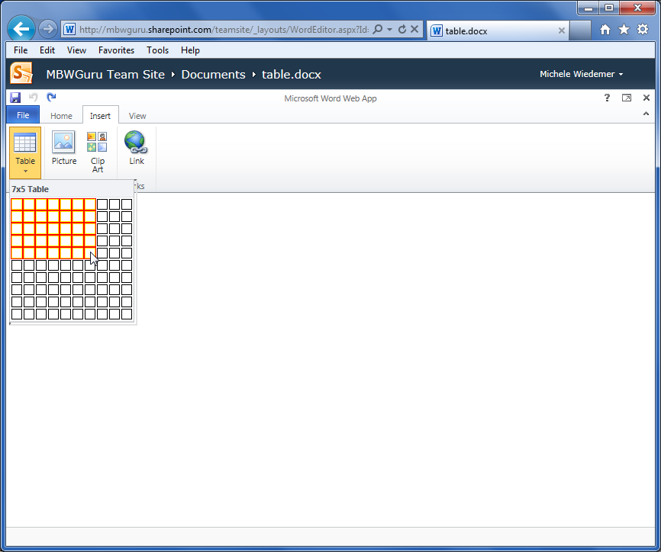
Inserting a Table
Select the Insert tab from the Ribbon.
Select Table.
Highlight the number of rows and columns that you want to insert.
Notes:
To insert a table, use the following procedure.
1. Select the Insert tab from the Ribbon.
2. Select Table.
3. Highlight the number of rows and columns that you want to insert.
Word inserts the table in the document at the current cursor position.

Slide 89
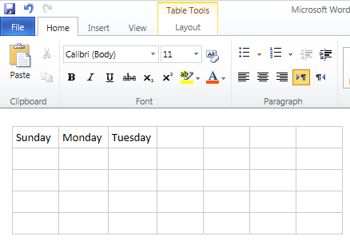
Adding Text to a Table
Click on the table cell you want to change.
Begin typing.
To enter text in another cell, click on that cell.

Slide 90
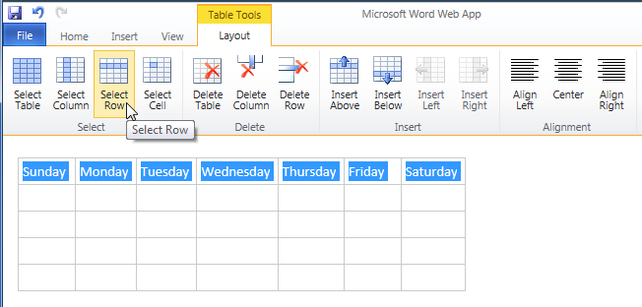
Working with Tables
The Table Tools tab.
Notes:
To select items in the table, use the following procedure.
1. Place the cursor in the row or column that you want to select.
2. Click on the selection tool.
To use the Alignment tools, use the following procedure.
1. Select the rows, columns or cells (or the whole table) that you want to align.
2. Click on the Alignment tool.
To insert a row, use the following procedure.
1. Place the cursor in a row above or below where you want the new row.
2. Click the Insert tool.
Note that the new row is not selected or highlighted in any way.
To delete a row, use the following procedure.
1. Place the cursor in the row you want to delete.
2. Click the Delete Row tool.

Slide 91
Inserting Links
Select the text that you want to use as a link.
Select the Insert tab from the Ribbon.
Select the Link tool.
In the Link dialog box, enter the Address for your link. It can be any web URL, including another document from your SharePoint team site.
You can change the Display text, if desired.
Select Insert.
Notes:
Select the text that you want to use as a link.
Select the Insert tab from the Ribbon.
Select the Link tool.
In the Link dialog box, enter the Address for your link. It can be any web URL, including another document from your SharePoint team site.
You can change the Display text, if desired.
Select Insert.

Slide 92
Module Ten: Review Questions
1. The Word web app does not allow you to insert tables.
  True
  False
2. In the Word web app, you need to enter the number of columns and rows you want in the Insert Table dialog box.
  True
  False
3. You can add text to a table by pasting the clipboard contents.
  True
  False
4. The Table Tools tab does NOT include which of the following options?
  Select Table
  Borders
  Insert Column
  Delete Row

Slide 93
Module Ten: Review Questions
5. You can align the text in a table cell left, center, or right.
  True
  False
6. The Link dialog box includes a tool to help you locate the address for your link.
  True
  False
7. You can change the display text for your link in the Link dialog box.
  True
  False

Slide 94
Module Ten: Review Questions
1. The Word web app does not allow you to insert tables.
  True
  False
2. In the Word web app, you need to enter the number of columns and rows you want in the Insert Table dialog box.
  True
  False
3. You can add text to a table by pasting the clipboard contents.
  True
  False
4. The Table Tools tab does NOT include which of the following options?
  Select Table
  Borders
  Insert Column
  Delete Row

Slide 95
Module Ten: Review Questions
5. You can align the text in a table cell left, center, or right.
  True
  False
6. The Link dialog box includes a tool to help you locate the address for your link.
  True
  False
7. You can change the display text for your link in the Link dialog box.
  True
  False

Slide 96
Module Eleven: The Insert Tools (II)
Vision / It reaches beyond the thing that is, into the conception of what can be. Imagination gives you the picture. Vision gives you the impulse to make the picture your own.
Robert Collier
In this module, you’ll learn about using pictures with the Word web app. You’ll learn how to insert a picture from a file or from Clip Art. This module also introduces the Picture Tools tab; where there are a few commands to help you control the appearance of your picture in the web app.

Slide 97
Inserting Pictures
Place your cursor in the location in the document where you want the picture to appear.
Select the Insert Tab.
Select Picture.
In the Choose File to Upload dialog box, navigate to the location of the picture file you want to use. Highlight the file and select Open.
Notes:
To insert a picture, use the following procedure.
1. Place your cursor in the location in the document where you want the picture to appear.
2. Select the Insert Tab.
3. Select Picture.
4. In the Choose File to Upload dialog box, navigate to the location of the picture file you want to use. Highlight the file and select Open.
The file must be uploaded to the site, so the insertion may take a few moments, depending on the size of the file and the connection speed.

Slide 98
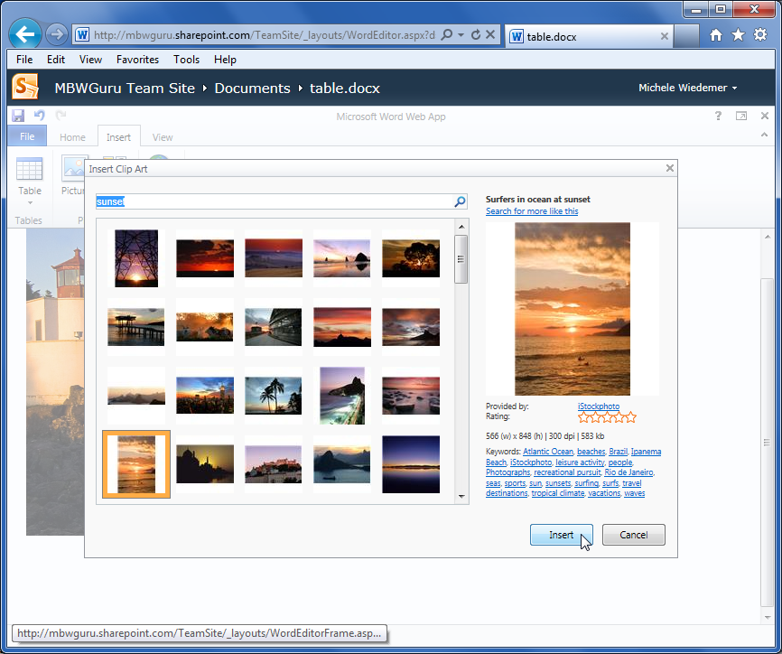
Inserting Clip Art
Notes:
1. Place your cursor in the location in the document where you want the Clip Art to appear.
2. Select the Insert Tab.
3. Select Clip Art.
4. In the Insert Clip Art dialog box, enter one or more keywords to describe the type of image you want.
5. Select the Magnifying glass to begin the search.
6. Any matching images are displayed. Highlight the one you want to use. You can read a description with more information about the image on the right.
7. Select Insert.

Slide 99
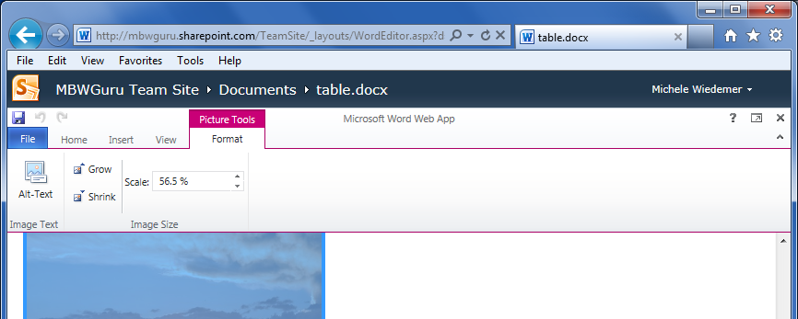
Working with Pictures
The Picture Tools tab.
Notes:
To provide Alternative Text for the image, use the following procedure.
1. Select the picture you want to modify.
2. Select the Picture Tools tab from the Ribbon.
3. Select Alt Text.
4. In the Alternative Text dialog box, enter the text to appear if the picture does not show for some reason.
5. Select OK.
To Grow or Shrink an image, use the following procedure.
1. Select the picture you want to modify.
2. Select the Picture Tools tab from the Ribbon.
3. Select Grow to make the image larger. Select Shrink to make the image smaller. Notice that the number in the Scale box changes.
To Scale the image, use the following procedure.
1. Select the picture you want to modify.
2. Select the Picture Tools tab from the Ribbon.
3. Use the Up or Down arrows next to Scale to change the size of the picture one percentage point at a time. You can also enter a new percentage in the Scale box.

Slide 100
Module Eleven: Review Questions
1. You can insert a picture into a Word web app document by dragging the picture from Windows Explorer and dropping it onto the document.
  True
  False
2. Which of the following items is NOT on the Insert tab?
  Table
  Picture
  Link
  Chart
3. You can insert a picture from a file on your network or computer.
  True
  False
4. To search Microsoft’s Clip Art collection you need to enter a search keyword.
  True
  False

Slide 101
Module Eleven: Review Questions
5. Which of the following tools is NOT on the Picture Tools tab?
  Alt Text
  Grow
  Shrink
  Link
6. The Grow command makes your picture larger by one percentage point at a time.
  True
  False
7. You can enter an exact percentage size in the Scale box.
  True
  False

Slide 102
Module Eleven: Review Questions
1. You can insert a picture into a Word web app document by dragging the picture from Windows Explorer and dropping it onto the document.
  True
  False
2. Which of the following items is NOT on the Insert tab?
  Table
  Picture
  Link
  Chart
3. You can insert a picture from a file on your network or computer.
  True
  False
4. To search Microsoft’s Clip Art collection you need to enter a search keyword.
  True
  False

Slide 103
Module Eleven: Review Questions
5. Which of the following tools is NOT on the Picture Tools tab?
  Alt Text
  Grow
  Shrink
  Link
6. The Grow command makes your picture larger by one percentage point at a time.
  True
  False
7. You can enter an exact percentage size in the Scale box.
  True
  False

Slide 104
Module Twelve:
Wrapping Up
Practice means to perform, over and over again in the face of all obstacles, some act of vision, of faith, of desire. Practice is a means of inviting the perfection desired.
Martha Graham
Although this workshop is coming to a close, we hope that your journey to improve your Word web app skills is just beginning. Please take a moment to review and update your action plan. This will be a key tool to guide your progress in the days, weeks, months, and years to come. We wish you the best of luck on the rest of your travels!

Slide 105
Words from the Wise
Remember that the web app is designed to make just a few edits available from almost anywhere. Use Word 2010 to do more complicated edits.
You can check your spelling and format your fonts in the Word web app
The Word web app includes a few paragraph formatting tools to enhance the look of your documents.
Use styles to ensure consistent formatting throughout your document.

